Slide 1
Trapping Specialization
Adhesive/snap traps
Transitional traps
Pitcher and pitcher-derived traps
1
2
6
8
Erect, trumpet-shaped pitchers
Nepenthes mirabilis
Nepenthes faizaliana
Sarracenia leucophylla
Sarracenia alata Heliamphora tatei
Heliamphora heterodoxa
Thin, filiform, adhesive leaves
Triphyophyllum peltatum
Drosophyllum lusitanicum
Drosera regina
Pinguicula heterophylla
Roridula gorgonias
Simple funnel-shaped pitchers,
adhesive inner walls
Nepenthes aristolochioides
Nepenthes talangensis
Nepenthes eymae
Aerial
3
7
9
Broad adhesive leaves
Pinguicula vulgaris
Pinguicula acuminata
Pinguicula ibarrae
Drosera schizandra
Drosera prostratoscaposa
Drosera cuneifolia
Highly curled adhesive leaf
Pinguicula lutea
Pinguicula grandiflora
Pinguicula villosa
(and many other Pinguicula)
Short, squat pitchers
Nepenthes ampullaria
Nepenthes rowanae
Sarracenia purpurea
Sarracenia rosea Cephalotus follicularis
Extinct pitcher plants*
Ground
4
10
Pitchers with eel-trap like mechanism
Darlingtonia californica (juvenile)
Sarracenia psittacina
Extinct pitcher plants*
Rapidly-closing traps
Drosera burmannnii
Drosera sessilifolia
Dionaea muscipula
Amphibious
5
11
Aquatic “pitchers”
Genlisea aurea
Genlisea repens
Utricularia wannani
Utricularia dichotoma
(and many other Genlisea and Utricularia)
Aquatic snap trap
Aldrovanda vesiculosa
Aquatic

Slide 2
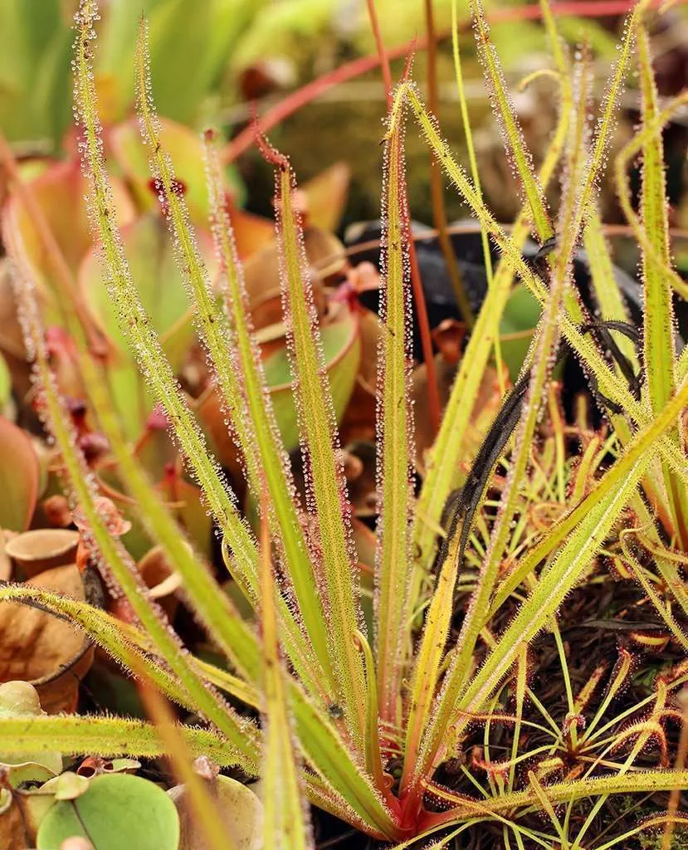
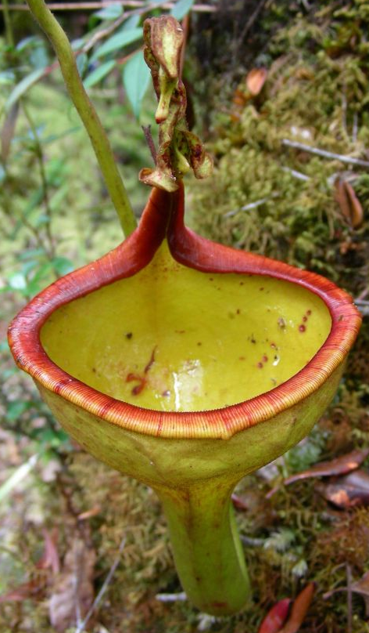
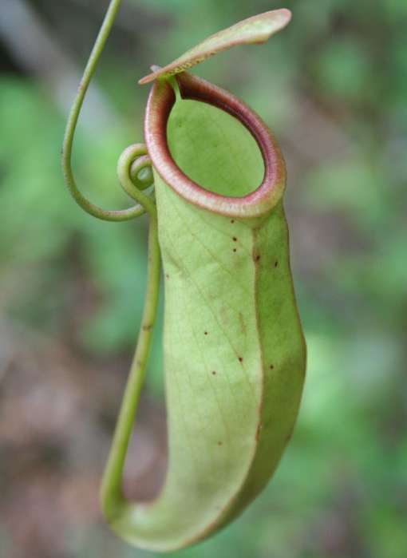
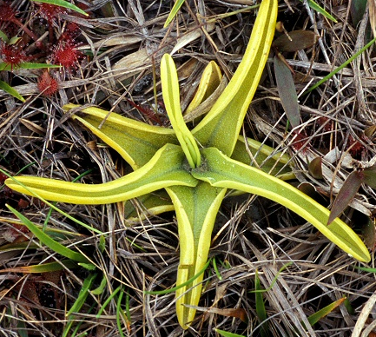
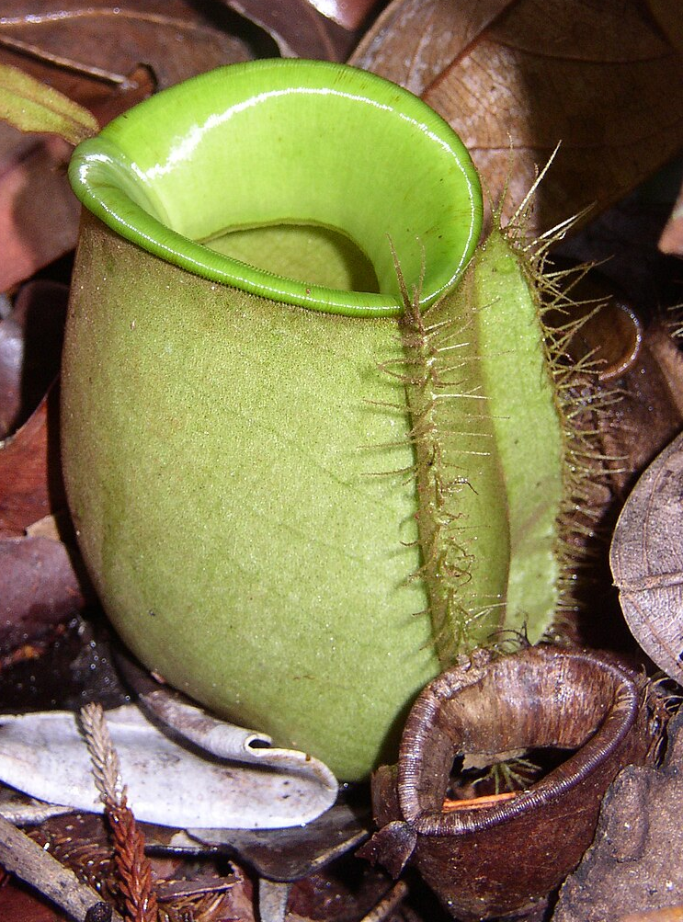
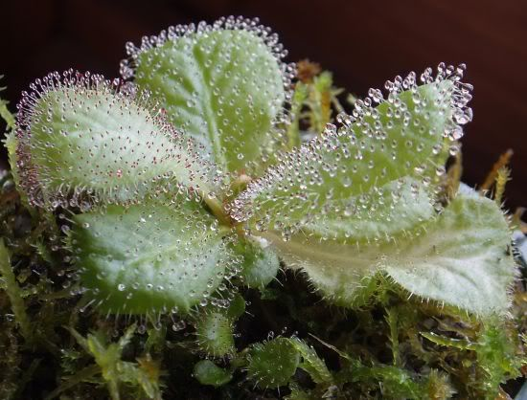
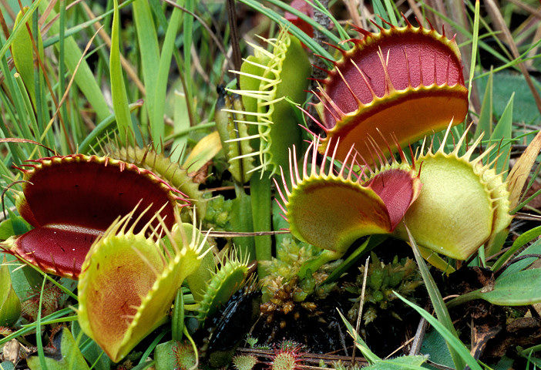
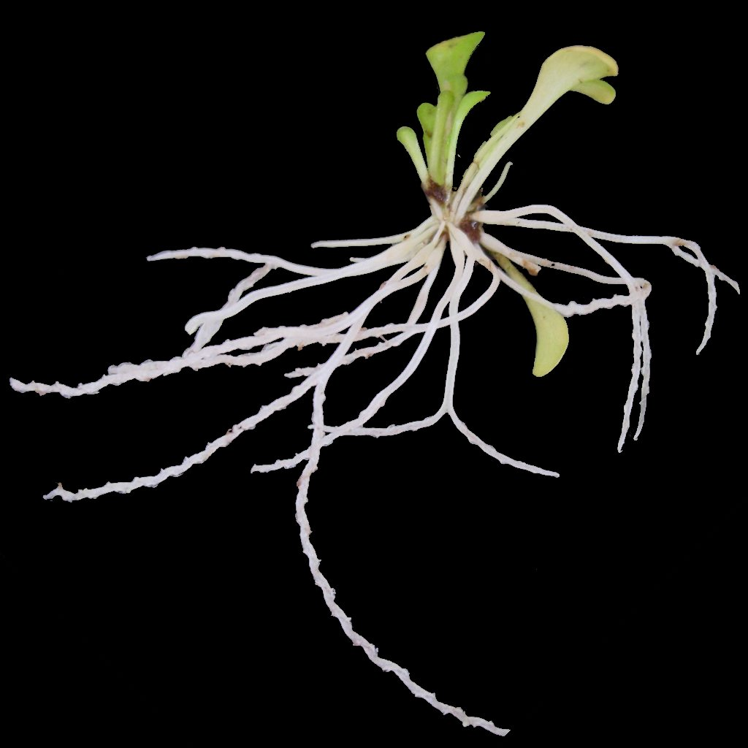
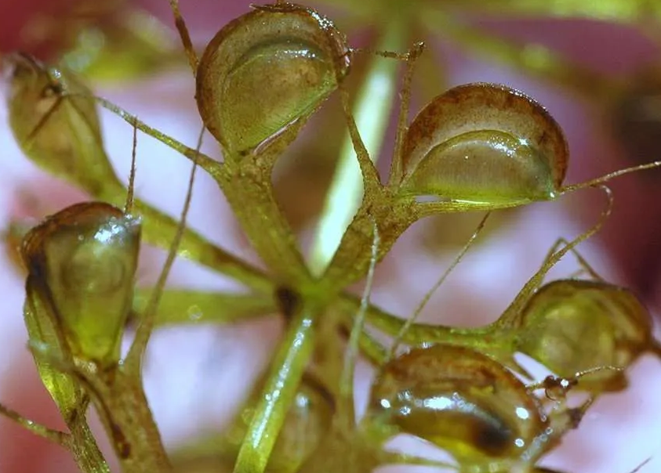
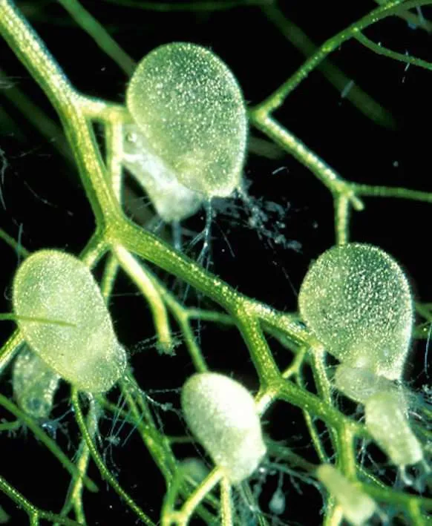
Trapping Specialization
Adhesive/snap traps
Adhesive/Pitcher Intermediate traps
Pitcher and pitcher-derived traps
1
2
6
8
Erect, trumpet-shaped pitchers
Nepenthes mirabilis
Nepenthes faizaliana
Sarracenia leucophylla
Sarracenia alata Heliamphora tatei
Heliamphora heterodoxa
Thin, filiform, adhesive leaves
Triphyophyllum peltatum
Drosophyllum lusitanicum
Drosera regina
Pinguicula heterophylla
Roridula gorgonias
Simple funnel-shaped pitchers,
adhesive inner walls
Nepenthes aristolochioides
Nepenthes talangensis
Nepenthes eymae
Aerial
3
7
9
Broad adhesive leaves
Pinguicula vulgaris
Pinguicula acuminata
Pinguicula ibarrae
Drosera schizandra
Drosera prostratoscaposa
Drosera cuneifolia
Highly curled adhesive leaf
Pinguicula lutea
Pinguicula grandiflora
Pinguicula villosa
(and many other Pinguicula)
Short, squat pitchers
Nepenthes ampullaria
Nepenthes rowanae
Sarracenia purpurea
Sarracenia rosea Cephalotus follicularis
Extinct pitcher plants*
Ground
4
10
Pitchers with eel-trap
Darlingtonia californica (juvenile)
Sarracenia psittacina
Extinct pitcher plants*
Genus Genlisea (e.g. G. aurea)
Rapidly-closing traps
Drosera burmannnii
Drosera sessilifolia
Dionaea muscipula
Amphibious
Gain of Carnivory
5
Pitcher Hypothesis for the Origin of Utricularia
11
Aquatic “pitchers”
Genlisea aurea
Genlisea repens
Utricularia wannani
Utricularia dichotoma
(and many other Genlisea and Utricularia)
Aquatic
Aquatic snap trap
Aldrovanda vesiculosa
Darwin Hypothesis for the Origin of Dionaea/ Aldrovanda

Slide 3
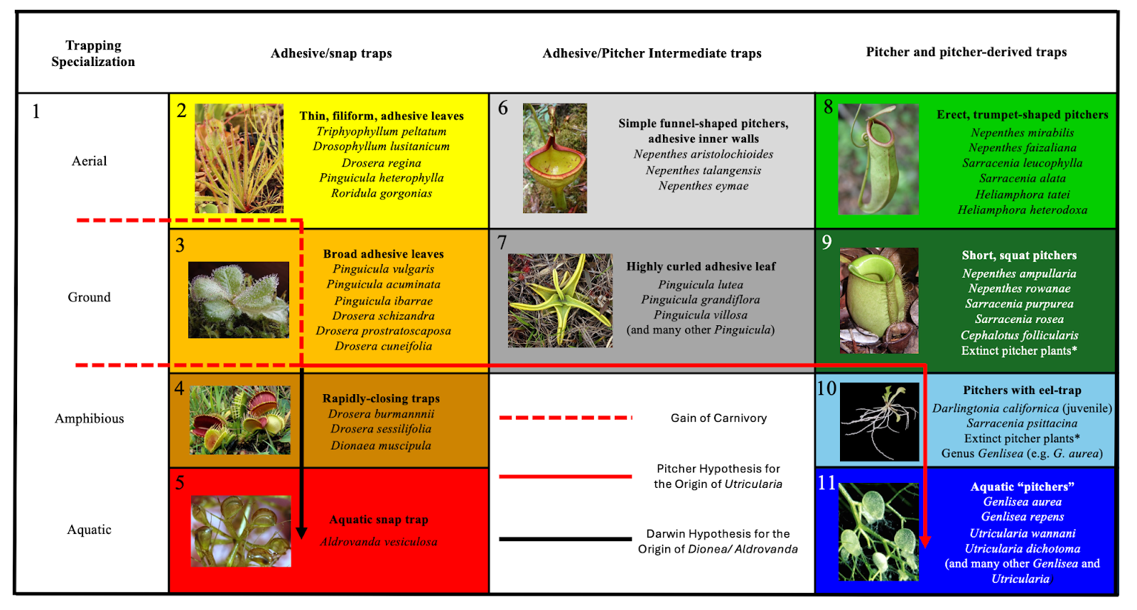
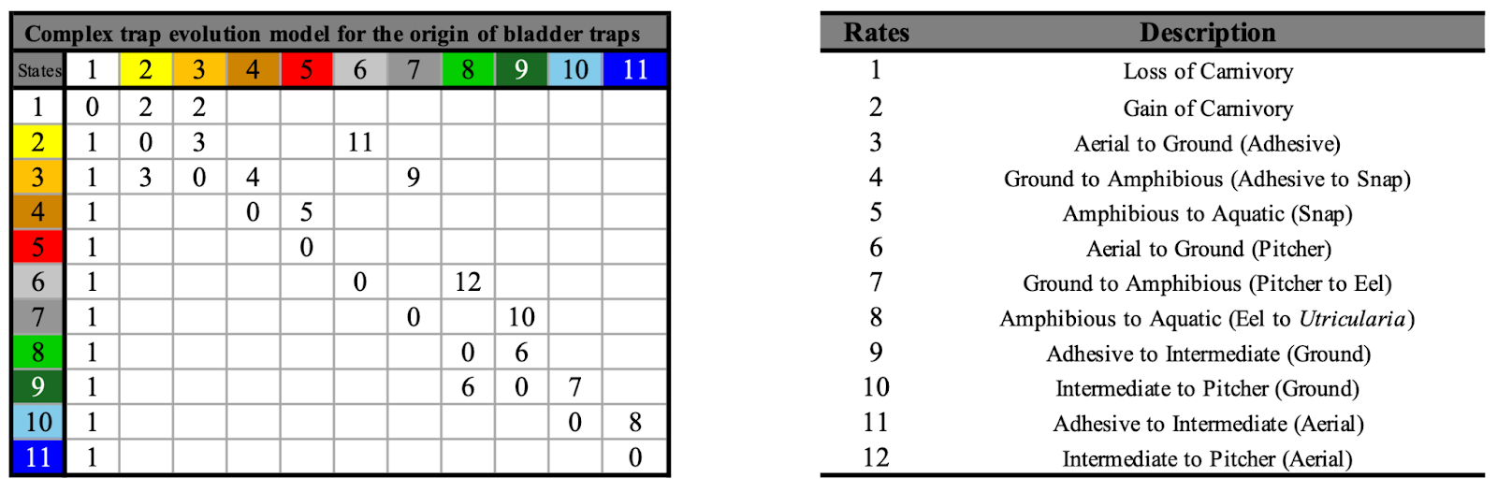
a
a
b

Slide 4
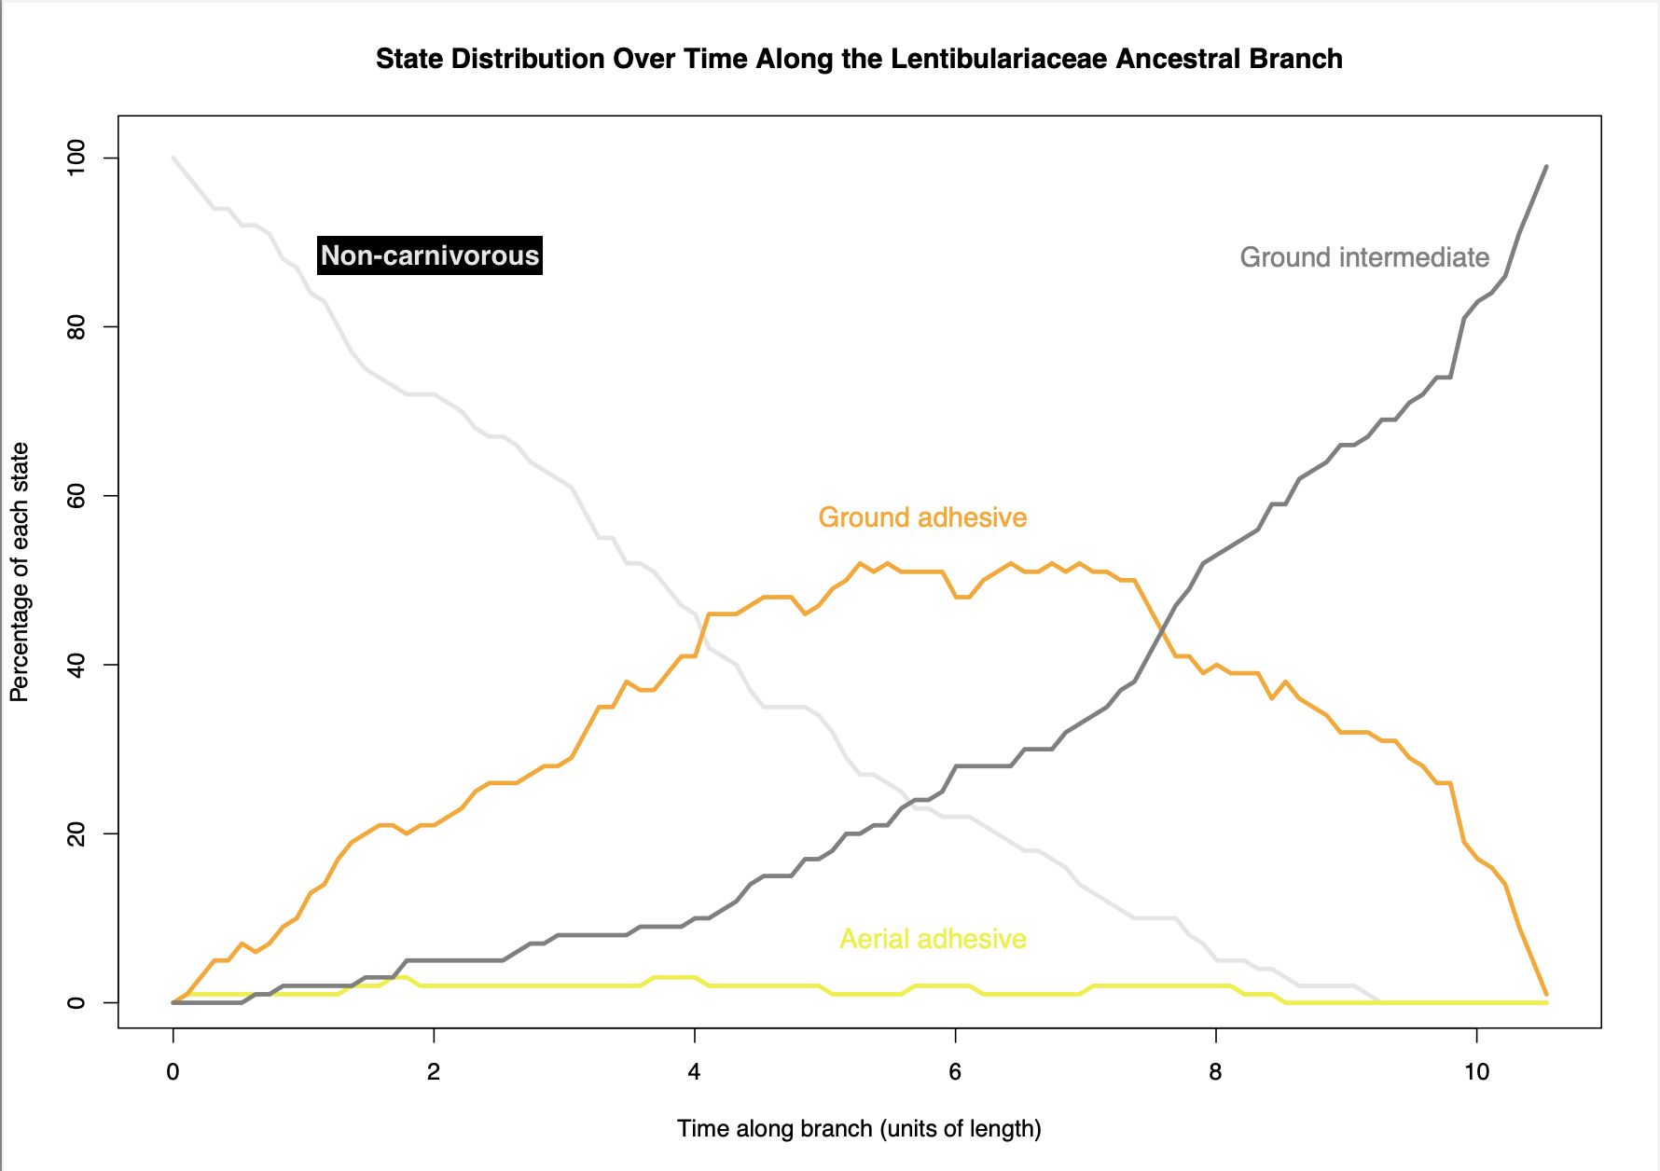
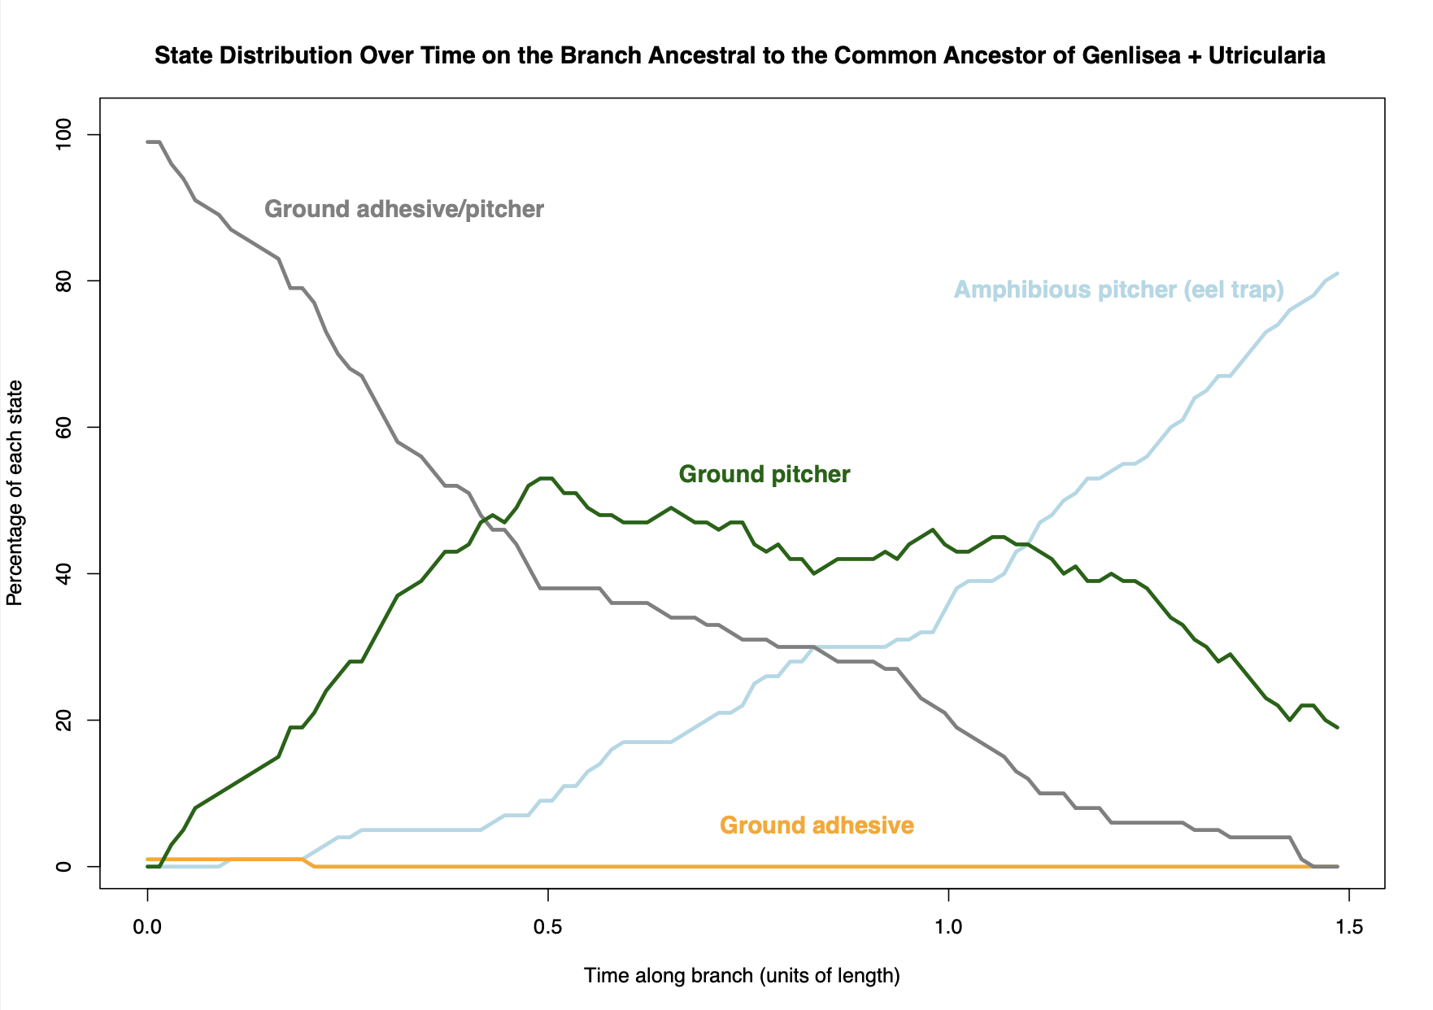
a
b

